Slide 1
Interactive HR Analytics Dashboard using Tableau
File created on: 5/11/2023
By Merin Raju

Slide 2
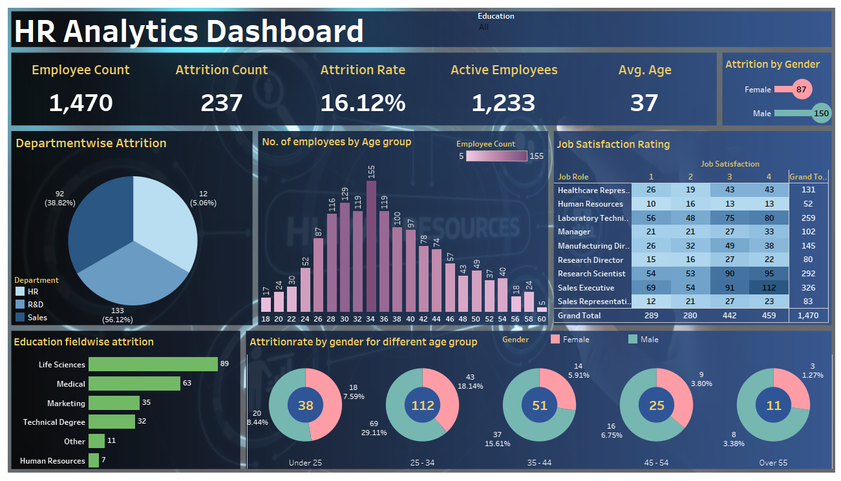

Slide 3
The HR Data.xlsx was used to generate the HR Analytics Dashboard.
The data set is cleaned and processed before being put into the tableau environment for analysis and dashboard construction.
The dashboard includes pie charts, heat maps, doughnut charts, lollipop charts, bar charts, and other visuals.
Its an interactive dashboard where the values changes as you click on different charts
Below are the summary that we made from the dashboard:
On average, employees at the company are 37 years old
The rate of employees leaving the organization is 16.12% and 237 employees left the organization
There are more men than women working at the company
The age group of 25 to 34 has the highest percentage of departing employees

